Slide 1
SMART HEATER
BY:
SUSHRUTH RADHAKRISHNA
SURYA TAMIRISA
SHUBHAM PATEL
TANAY DESAI

Slide 2
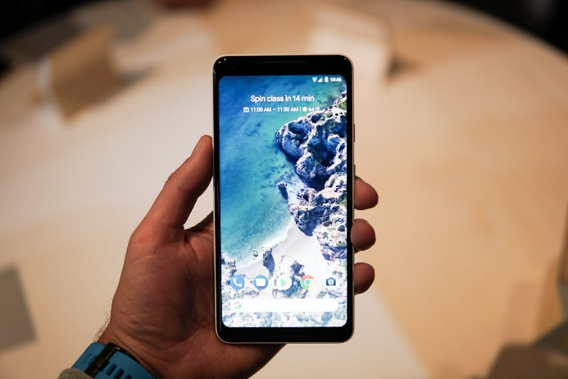


Idea
To monitor the temperature of coffee and switch on the coffee heater remotely, from a phone.

Slide 3
What’s the Big Thing?
This is a generic application which could be used to maintain three parameters of a system:
Temperature
Pressure
Humidity
The system could be as small as a coffee cup all the way to medical equipment.

Slide 4
How it will work?
The system is designed to help users to reheat their coffee mug.
We have a altitude and pressure sensor on raspberry pie and the data of both sensor is send to cloud i.e. Google firebase which in turn return the optimum boiling temperature of coffee.
A heating coil is keep inside the coffee mug to heat the liquid.
Other sensor i.e. temperature is also kept inside the coffee mug to measure the optimum temperature of coffee.
Whenever the user put down the coffee mug, the temperature sensor detect the temperature of coffee.

Slide 5
How it will work?
If the temperature of coffee is less than the value came from the cloud, the circuit will start to heat the coffee.
If the temperature of coffee is equal to or greater than the value came from cloud, the circuit will stop to heat the coffee.
The user can also manually disconnect the circuit with the help of android app with is link with system.
Moreover if there is any change in the altitude or in the pressure the optimum boiling temperature of coffee also changes .

Slide 6
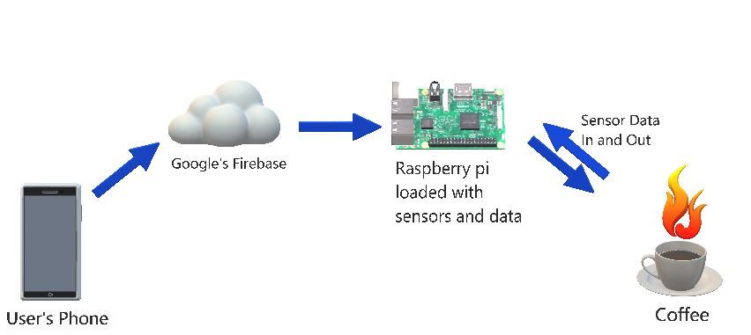
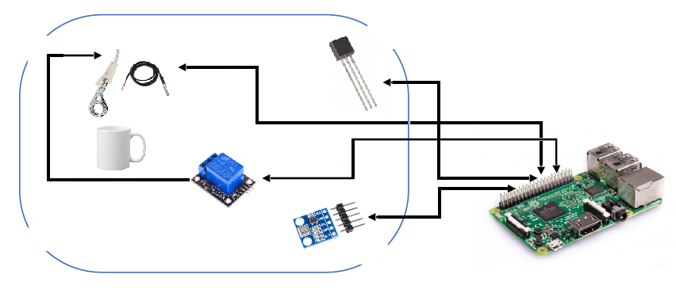
Flow diagram
Notes:
The system is designed to help users to reheat their coffee mug.
We have a altitude and pressure sensor on raspberry pie and the data of both sensor is send to cloud i.e. Google firebase which in turn return the optimum boiling temperature of coffee.
A heating coil is keep inside the coffee mug to heat the liquid.
Other sensor i.e. temperature is also kept inside the coffee mug to measure the optimum temperature of coffee.
Whenever the user put down the coffee mug, the temperature sensor detect the temperature of coffee.
If the temperature of coffee is less than the value came from the cloud, the circuit will start to heat the coffee.
If the temperature of coffee is equal to or greater than the value came from cloud, the circuit will stop to heat the coffee.
The user can also manually disconnect the circuit with the help of android app with is link with system.
Moreover if there is any change in the altitude or in the pressure the optimum boiling temperature of coffee also changes .

Slide 7
Hardware Tech Spec
Raspberry pi : 64-bit ARMv8 Quad-Core Processor at 1.2 GHz.
Sensor : Temperature, Pressure and Altitude.
Connectivity : Wi-Fi
Preferred Cloud : Google Firebase
User App : Android
Programming Language: Python
Cypress board : Output of sensor is analog and to convert to digital cypress board is used.

Slide 8
Why Raspberry pi?
A fully functional mini-computer with Linux operating system.
The ability to interface multiple devices.
It has an inbuilt LAN ,Wi-Fi, Bluetooth, HDMI and USB Port.
Open source and huge collection of readily available libraries.
Why Python?
Huge resources for Raspberry Pi integration.
Large Standard Library.
Simple programming language.

Slide 9
Protocol
Pressure and Altitude sensor - I2C Protocol
I²C (Inter-Integrated Circuit) is a multi master, multi salve, packet switched, single ended, serial computer bus.
It is typically used for attaching lower-speed peripheral ICs to processors and microcontrollers in short-distance, intra-board communication.
Almost all of the IoT devises use this protocol to communicate with each other in a closed network of sensors, hardware and cloud.

Slide 10
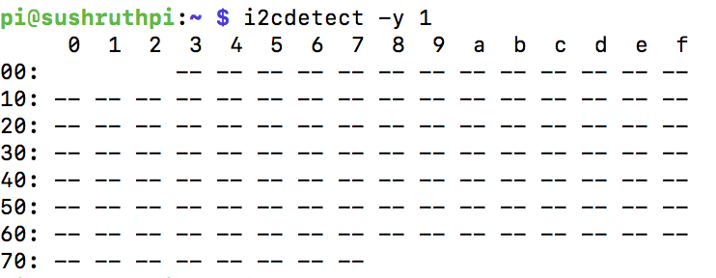
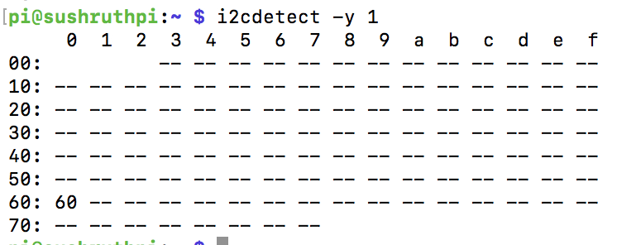
Protocol

Slide 11
Protocol
Temperature and Humidity sensor- UART
A universal asynchronous receiver-transmitter (UART) is a computer hardware device for asynchronous serial communication in which the data format and transmission speeds are configurable.
The electric signalling levels and methods are handled by a driver circuit external to the UART.
A UART is usually an individual (or part of an) integrated circuit used for serial communication over a computer or peripheral device serial port.

Slide 12
Single bus serial communication using UART:
40 bits of data transmitted – from sensor
0-15 – Temperature(MSB – positive or negative) – 16 bits
16-31 – Humidity(MSB – positive or negative) - bits
32-39 – Checksum – 8 bits

Slide 13
Work Process
There are two modules in the flow:
Module 1:
Module 2:

Slide 14
How is the application communicating with the database?
The users android application is connected to Google’s Firebase, a realtime database.
Firebase is run by MongoDB, which is a NoSQL database program.
Firebase requires your application to use google play services
It uses json documents to read and write data.
Notes:
When exchanging data between a browser and a server, the data can only be text.
JSON is text, and we can convert any JavaScript object into JSON, and send JSON to the server.
We can also convert any JSON received from the server into JavaScript objects.
This way we can work with the data as JavaScript objects, with no complicated parsing and translations.

Slide 15
How to connect to firebase?
Authenticate the user, by generating a signed key/certificate, which uses the SHA-1 protocol.
Create a database in Firebase using the signed key.
Add the firebase libraries/dependencies to your development environment.
Notes:
In cryptography, SHA-1 (Secure Hash Algorithm 1) is a cryptographic hash function designed by the United States National Security Agency and is a U.S. Federal Information Processing Standard published by the United States NIST.
including TLS and SSL, PGP, SSH, S/MIME
The app requires the google play services dependencies.

Slide 16
Firebase
The firebase can be setup using the GUI through the web browser or through code in the development environment.
The Elements in firebase are updated from the raspberry pi readings.
Raspberry pi integrates to the firebase through python script.

Slide 17
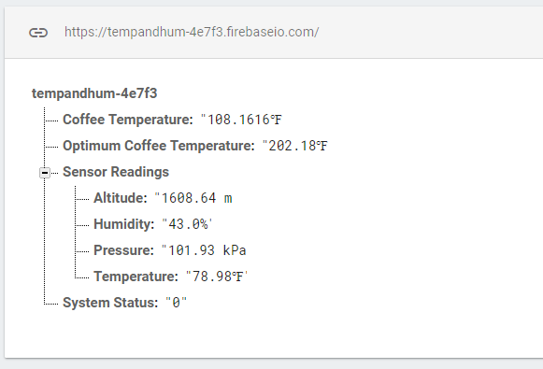
A detailed view of the DB
Notes:
Children parent hierarchy
If we have multiple records, every record is a parent and the information in it is saved as its children.

Slide 18
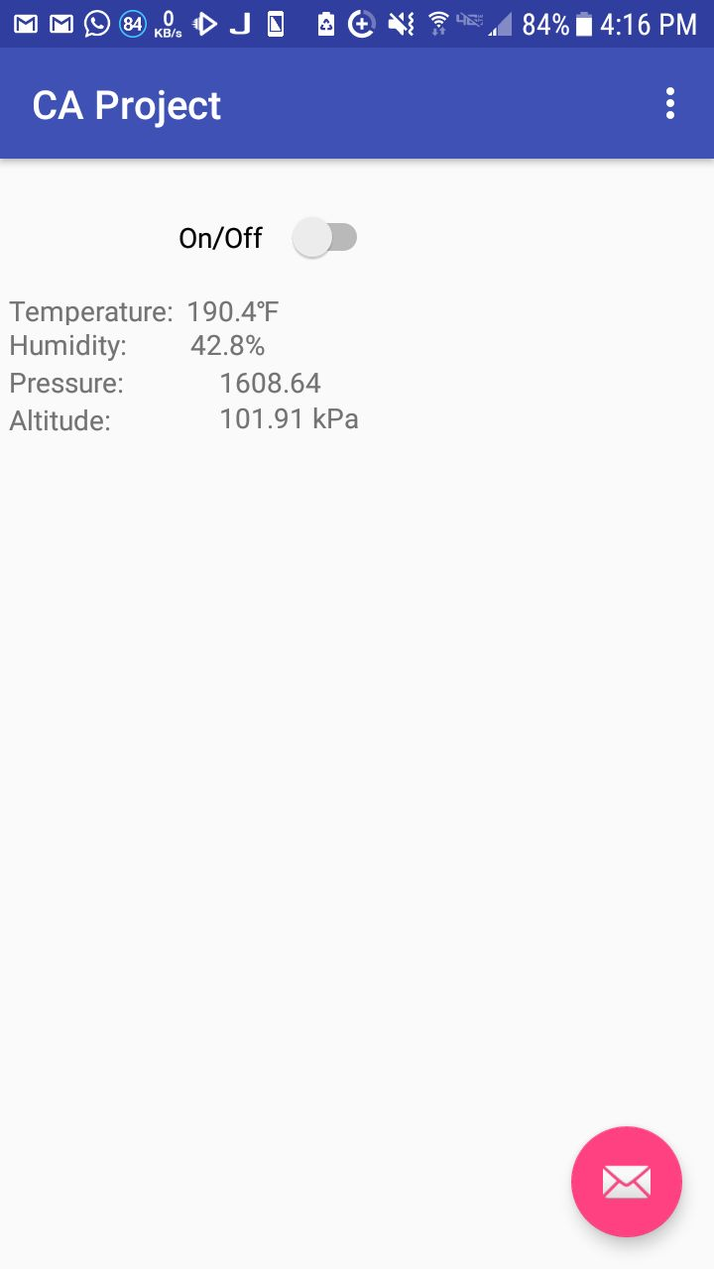
Android Application

Slide 19
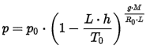
Formula
Atmospheric Pressure : To get pressure at different altitude
Parameter | Description | Value
p₀ | Sea Level Standard Atmospheric Pressure | 101.325 kPa
L | Temperature Lapse Rate, = G/C_{p} For Dry Air | 0.0065 K/m
T₀ | Sea Level Standard Temperature | 288.15 K
g | Earth-surface Gravitational Acceleration | 9.81 m/s²
M | Molar Mass Of Dry Air | 0.029 kg/mol
R₀ | Universal Gas Constant | 8.32 J/(mol•K)

Slide 20
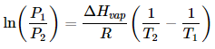
Formula
Clausius Clapeyron Equation : To get temperature at different pressure.
Parameter | Description | Value
p₁ | Atmospheric Pressure At Temperature T1 | kPa
P₂ | Atmospheric Pressure At Temperature T2 | kPa
ΔH vap | Heat Of Vaporization | 40.7 kJ/mol
R | Gas Constant | 8.32 J/(mol•K)
T1 | Temperature At Pressure 1 | K
T2 | Temperature At Pressure 2 | K

Slide 21
Graph Analysis
From Altitude Sensor | From Pressure Sensor
Altitude (m) | Pressure (kPa)
0 | 101.325
1000 | 89.86
2000 | 79.46
3000 | 70.06
4000 | 61.57
5000 | 53.96
6000 | 47.12
7000 | 40.99
8000 | 35.53
9000 | 30.68
10000 | 26.37
11000 | 22.57
12000 | 19.23
13000 | 16.29

Slide 22
Graph Analysis
From Pressure Sensor | Clausis Clapeyron Equation
Pressure (kPa) | Temperature (*C)
101.325 | 100.1
89.86 | 96.62
79.46 | 93.23
70.06 | 89.79
61.57 | 86.35
53.96 | 82.91
47.12 | 79.42
40.99 | 75.92
35.53 | 72.41
30.68 | 68.85
26.37 | 65.28
22.57 | 61.68
19.23 | 58.05
16.29 | 54.38

Slide 23
Graph Analysis
From Altitude Sensor | Clausis Clapeyron Equation
Altitude (m) | Temperature (*C)
0 | 100.1
1000 | 96.62
2000 | 93.23
3000 | 89.79
4000 | 86.35
5000 | 82.91
6000 | 79.42
7000 | 75.92
8000 | 72.41
9000 | 68.85
10000 | 65.28
11000 | 61.68
12000 | 58.05
13000 | 54.38

Slide 25
Various Data
From Altitude Sensor | From Pressure Sensor | Every 100m increase in Altitude 1.2kPa decrease in pressure From Atmospheric Pressure Formula | From Clausis Clapeyron Equation | Every 150m increase in Altitude 0.5*C decrease in Temperature
Altitude (m) | Pressure (kPa) | Pressure (kPa) | Temperature(*C) | Temperature (*C)
0 | 101.325 | 101.32 | 100.1 | 100.01
1000 | 89.86 | 89.8894 | 96.62 | 96.67
2000 | 79.46 | 79.52 | 93.23 | 93.34
3000 | 70.06 | 70.145 | 89.79 | 90.01
4000 | 61.57 | 61.68 | 86.35 | 86.68
5000 | 53.96 | 54.06 | 82.91 | 83.35
6000 | 47.12 | 47.23 | 79.42 | 80.02
7000 | 40.99 | 41.12 | 75.92 | 76.69
8000 | 35.53 | 35.65 | 72.41 | 73.36
9000 | 30.68 | 30.81 | 68.85 | 70.03
10000 | 26.37 | 26.52 | 65.28 | 66.71
11000 | 22.57 | 22.68 | 61.68 | 63.37
12000 | 19.23 | 19.33 | 58.05 | 60.04
13000 | 16.29 | 16.39 | 54.38 | 56.71

Slide 27
Future Scope
Can be implemented
Medical equipments while transporting organs.
Chemical laboratory for maintain unstable compounds.
Home automation.
Flight simulators.

Slide 28
QUESTIONS?

